Slide 1

Navigating SMC in a Remote Education Environment: Using Canvas and Zoom
Tammara Whitaker – Associate Dean, Online Services & Support (Interim), Distance Education Department
Ashley Eutsey - Senior Online Learing Services Specialist-Distance Education
Christine Miller - Instructional Media Specialist
Willis Barton - Online Learning Services Specialist

Slide 2

Course Access
If you are a first time Canvas student, you should be able to log into Canvas (not classes) 2 weeks prior to the start of the semester.
Current Canvas users should have access to Canvas (not classes) at any time.
Please check the Class Schedule for start and end dates for all your classes.
Current Semester Access
Online classes are not accessible until the start date of the class
at 12:00 AM (midnight)
OR
12:00 AM (midnight) of
the day after you’ve
enrolled or were
reinstated, if the
class has already
started. ​
2

Slide 3
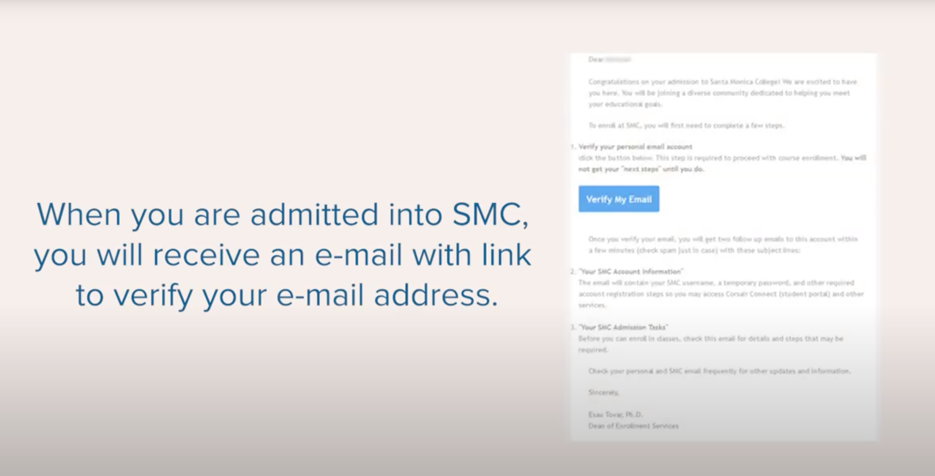
HOW TO ACCESS COSAIR CONNECT

Slide 4
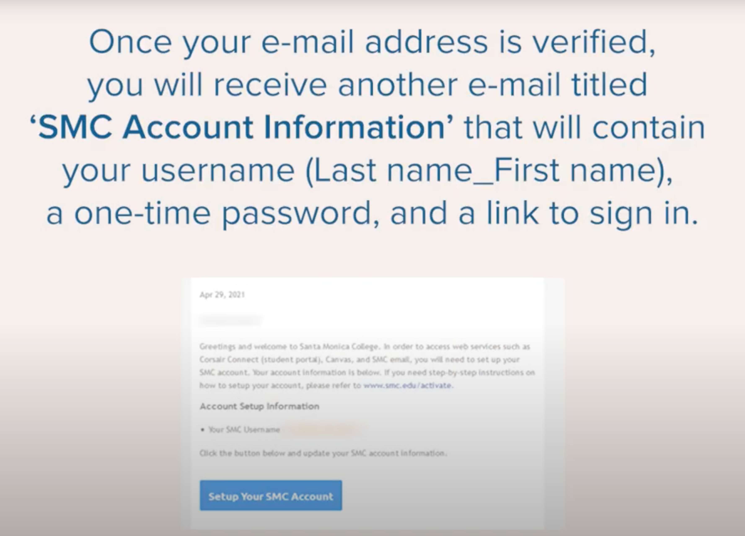
HOW TO ACCESS COSAIR CONNECT

Slide 5

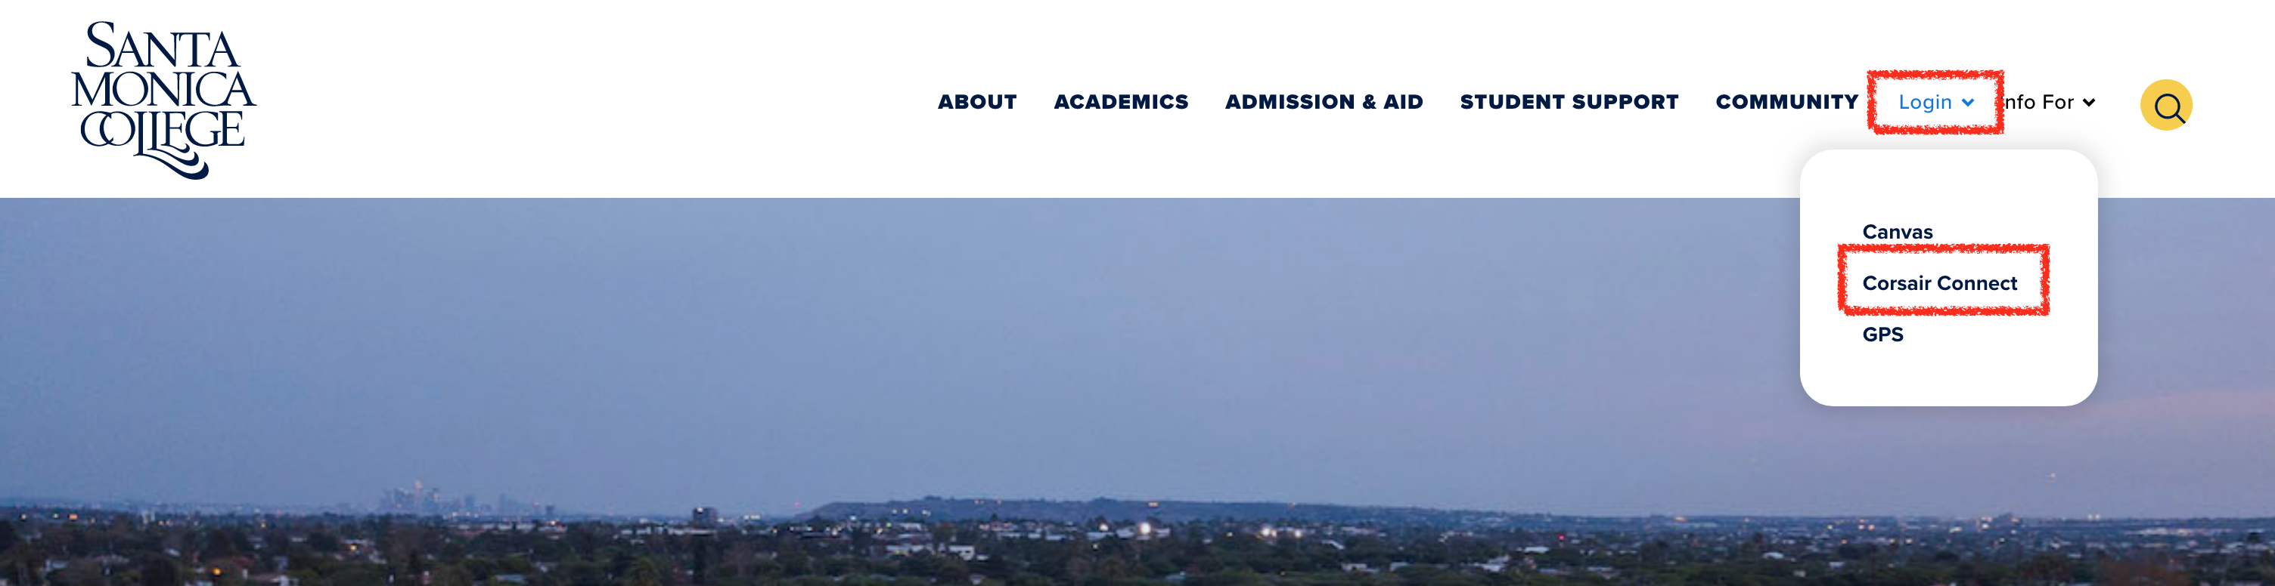
HOW TO ACCESS COSAIR CONNECT
Access your class schedule, SMC student email, add and drop classes, pay your fees, apply for financial aid, view your student records, and keep up to date with course dates and deadlines.
1. Go to www.smc.edu, and click on the login at the top of the page, then Corsair Connect OR go to www.smc.edu/cc

Slide 6
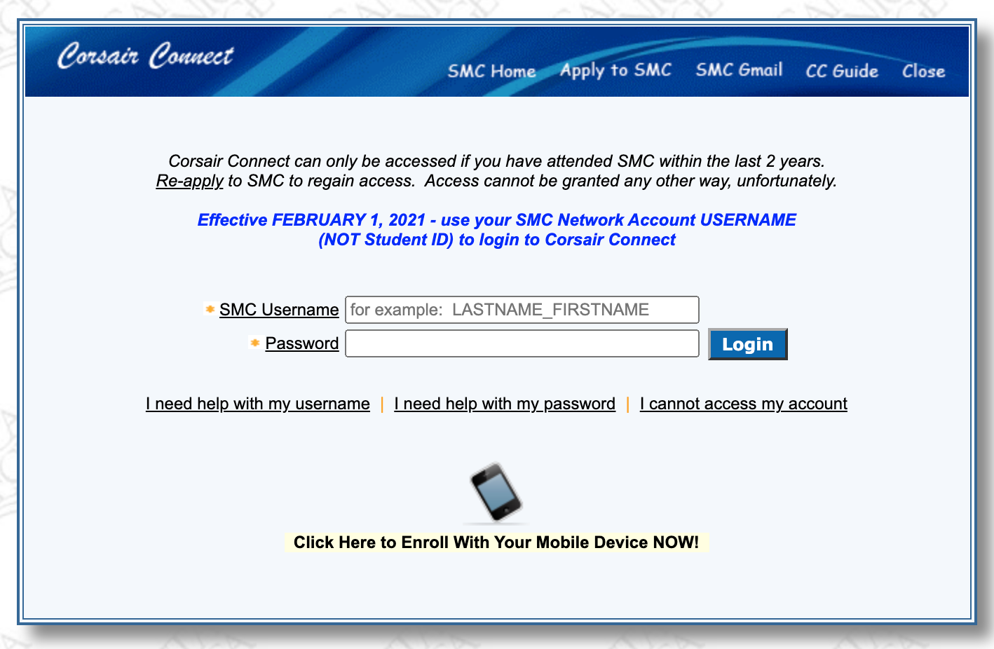
HOW TO ACCESS COSAIR CONNECT
2. Log in with your SMC Username and password.
Forgot your Username? Click on the I need help with my username link. If you are unable to find the initial welcome letter, email the Admissions & Records office at admissions@smc.edu using the email address you used on your application.

Slide 7

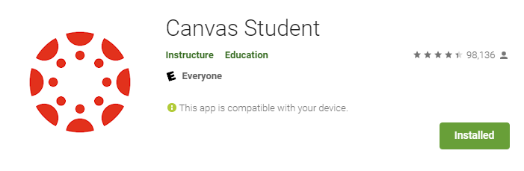

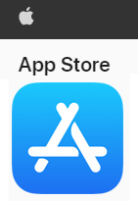
The Canvas Student App
Canvas Student allows students to access their courses and groups using a mobile device.
Students can submit assignments, participate in discussions, view grades and course materials.
Provides access to course calendars, To Do items, notifications, and Conversations messages.
Canvas Notification Settings
Canvas Student requires a Canvas account and is available for both Android and iOS devices.
8

Slide 8

The Canvas Help Desk
For technical issues with Canvas:
Call Canvas Helpdesk.
Chat with a Canvas Help Desk representative through the chat link on the Help and Academic Resources button on the Global Navigation.
  This support is available 24/7/365.
  Be specific about the problem you are experiencing.
  Include a screen shot of the error message.
  Contact your professor to let them know you are experiencing technical difficulties & share the Help Desk ticket # with them.
8

Slide 9

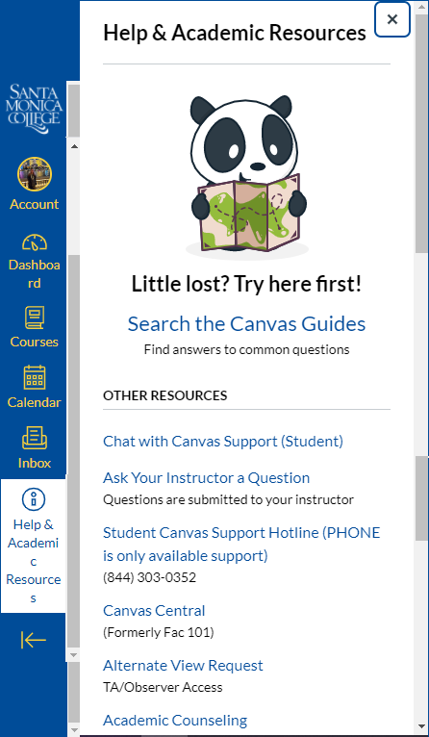
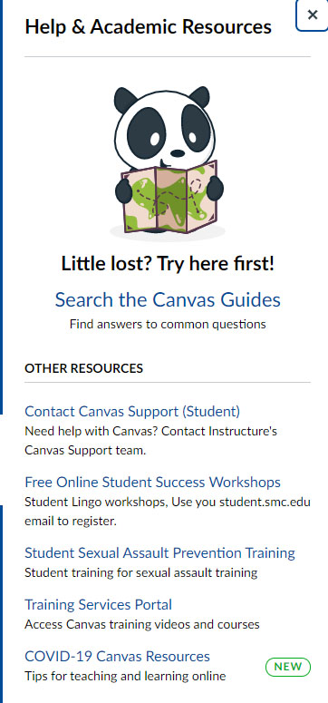
Contact the Canvas Help Desk for any of the following reasons:
Unable to see your courses
Unable to submit assignment
General How To questions that include contacting your instructor and/or navigating your course
10

Slide 10
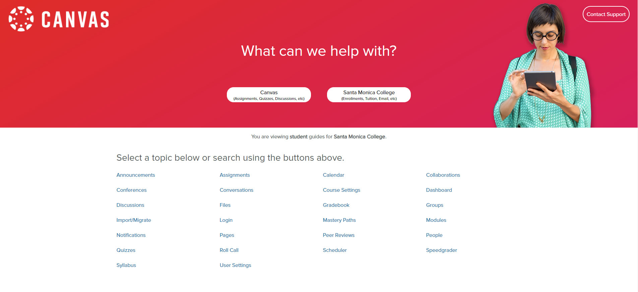
Contact the Canvas Help Desk for any of the following reasons:
Unable to see your courses
Unable to submit assignment
General How To questions that include contacting your instructor and/or navigating your course
11

Slide 11
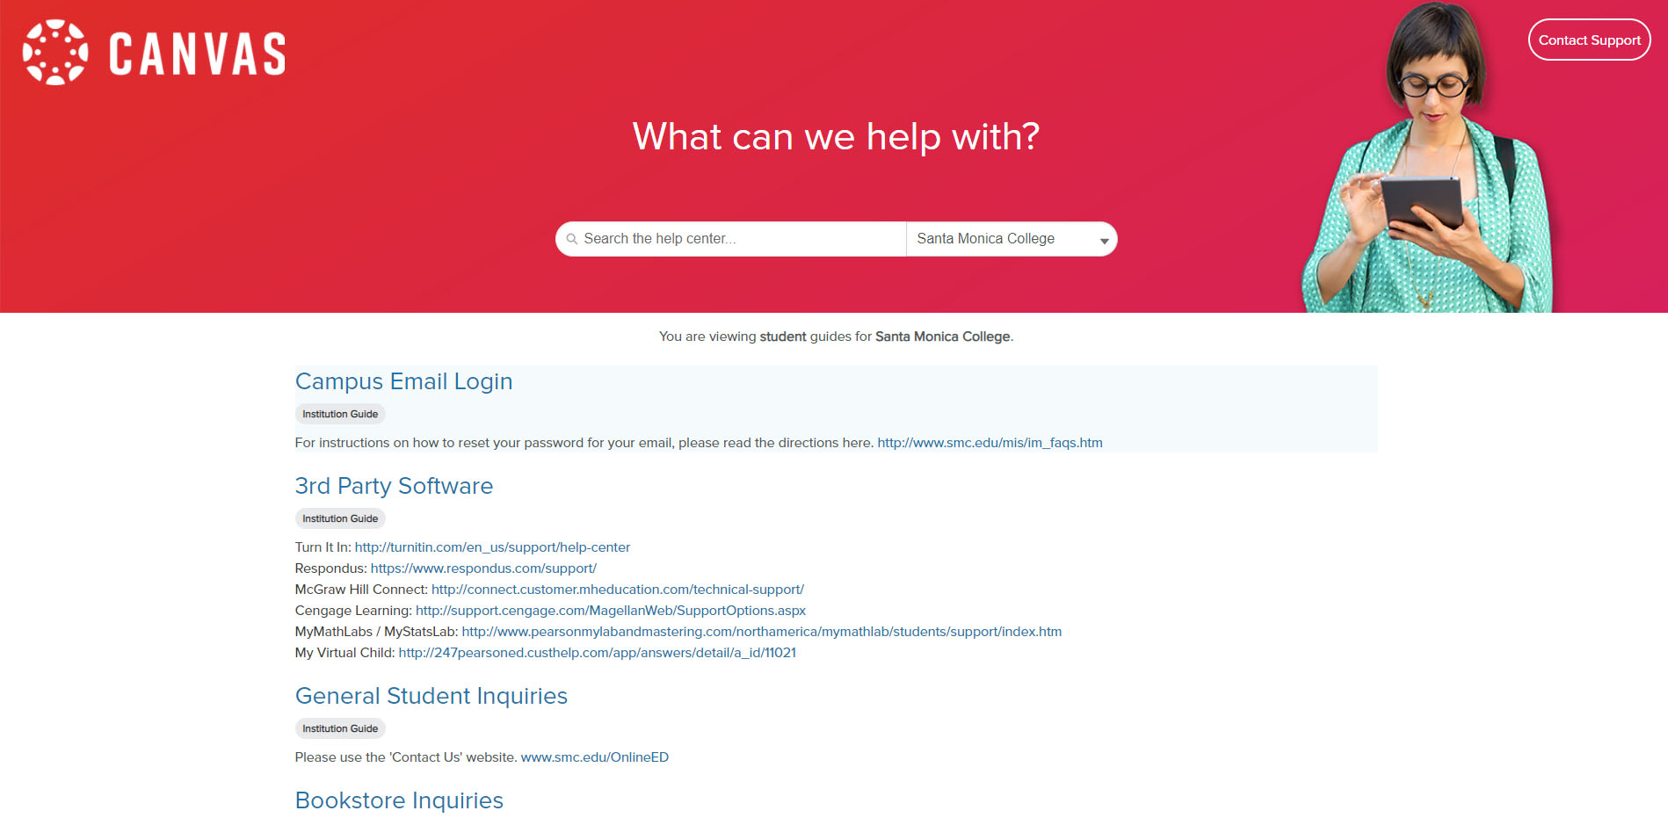
Contact the Canvas Help Desk for any of the following reasons:
Unable to see your courses
Unable to submit assignment
General How To questions that include contacting your instructor and/or navigating your course
12

Slide 12
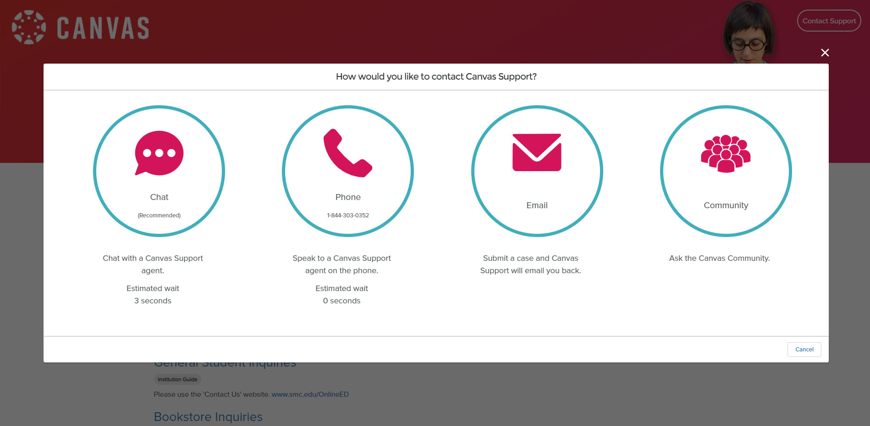
Contact the Canvas Help Desk for any of the following reasons:
Unable to see your courses
Unable to submit assignment
General How To questions that include contacting your instructor and/or navigating your course
13

Slide 13

Adding/Reinstating A Course
To add a course once the class has started:
Email the professor directly.
You can find the email address on the Santa Monica College website at the Employee Directory
You can search by employee type, department and/or last name.
When you find the professor, click on the email address to email them.
Please include your name, student I.D., and the name and section number of the class you wish to add.
To be reinstated in a course:
Contact your professor via email using the Employee Directory
Include your full name, Student I.D. Number, and name and section number of the class.
If the professor will permit a reinstate he/she will forward an Instructor Approval Code and instructions on how to proceed.
14

Slide 14
Issues or Problems with
Adding/Reinstating A Course
If you are still experiencing issues with the enrollment/reinstatement process:
Contact the professor and the Admissions Office at (310)-434-4380.
Remember, you will not have access to your class immediately. Late adds or reinstatements will have to wait for the enrollment system to process and can take anywhere from a couple hours or in some instances after midnight.
15

Slide 15
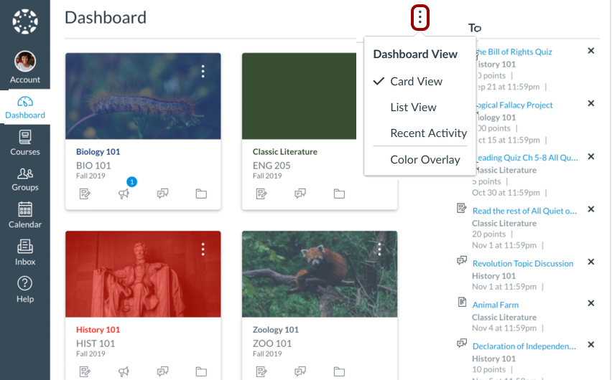
Remember, you won’t have access to the course until the very first day of the class start.
How to find your courses on the Canvas Dashboard.

Slide 16
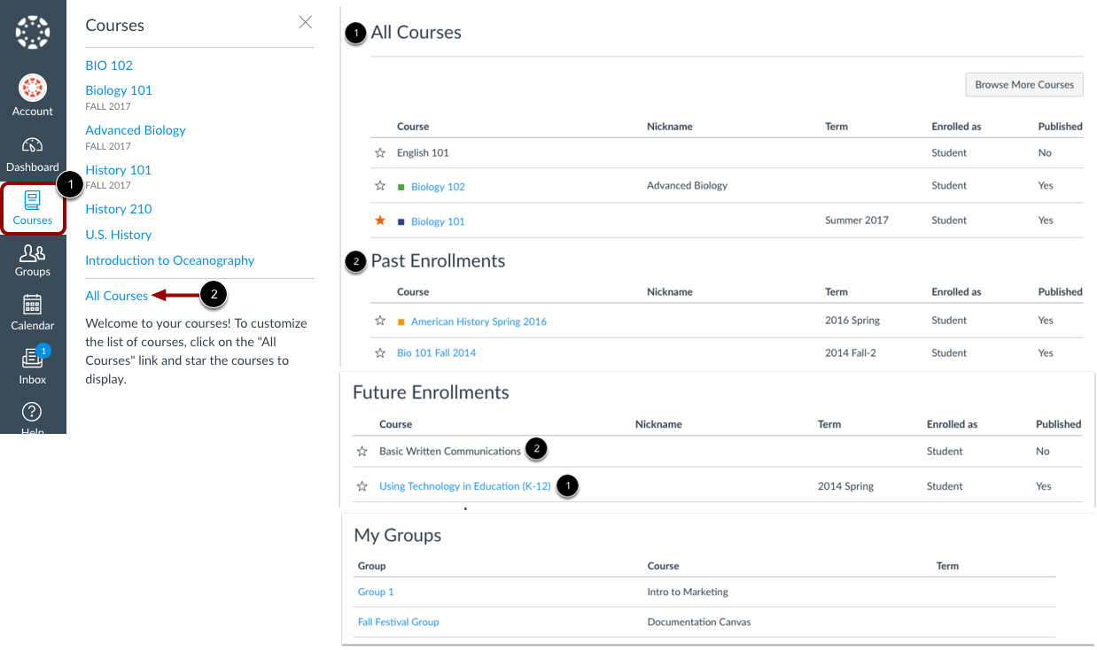
This area displays all of your current, future and past course enrollment.
Remember though, you won’t have access to the course until the very first day of the class start.
You can also find all your courses by going to Courses/All Courses.

Slide 17
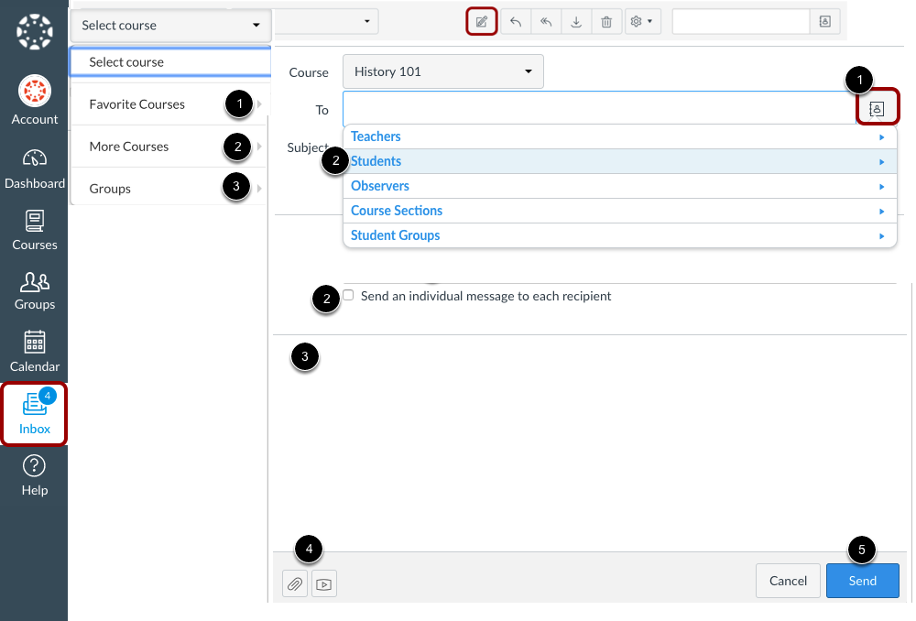
Always communicate with your instructor through their preferred method which is stated on their syllabus. Canvas Inbox Conversations and direct email are usually the best way to contact your instructor prior to the course starting.
18

Slide 18

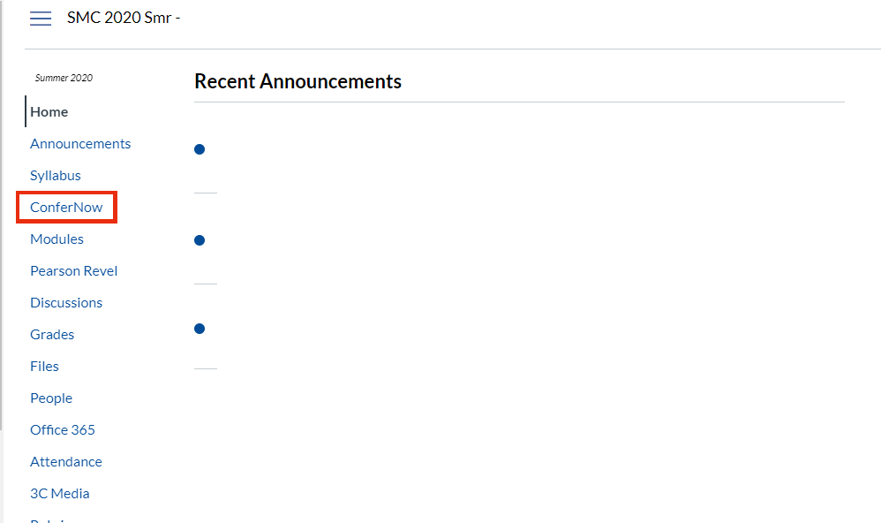
Zoom meetings can be scheduled two ways.
Within Canvas, it will be through ConferNow, located in the Course Navigation Menu.
18

Slide 19
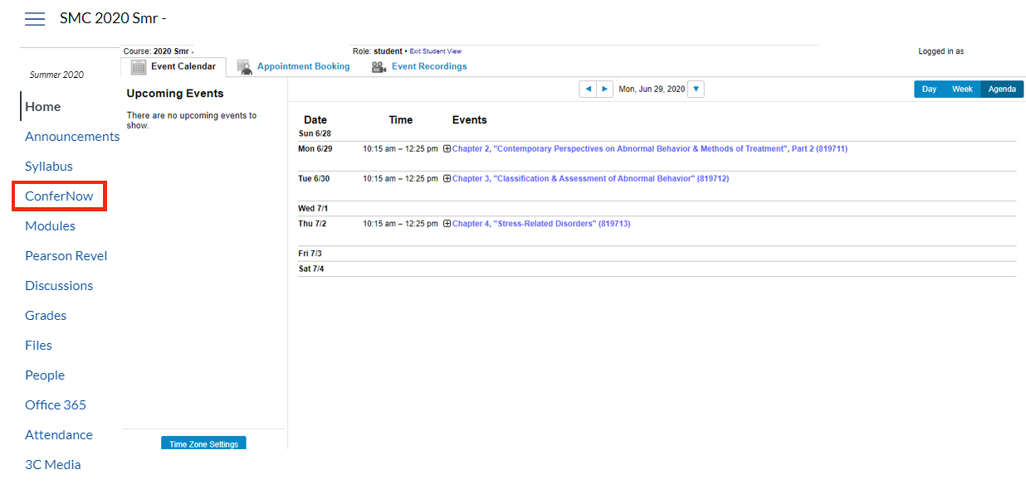
Zoom meetings can be scheduled two ways.
Within Canvas, it will be through ConferNow, located in the Course Navigation Menu. This is how your upcoming events will look.
19

Slide 20
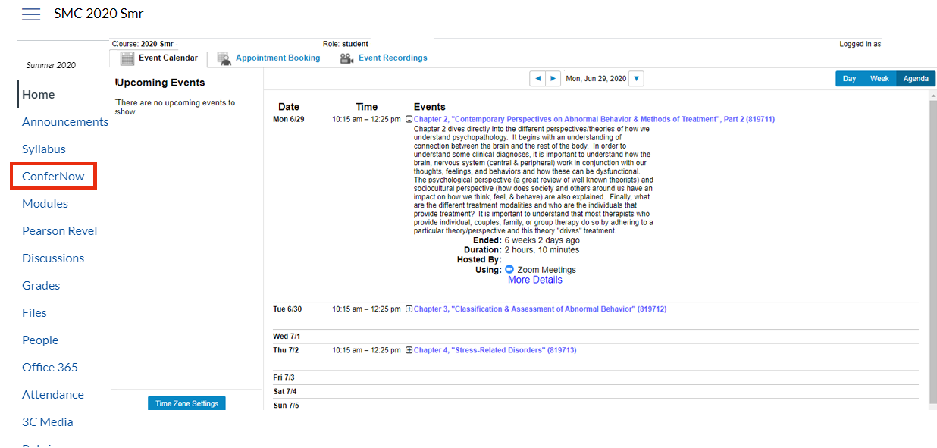
Zoom meetings can be scheduled two ways.
Within Canvas, it will be through ConferNow, located in the Course Navigation Menu. Click on the event to view details and join.
20

Slide 21
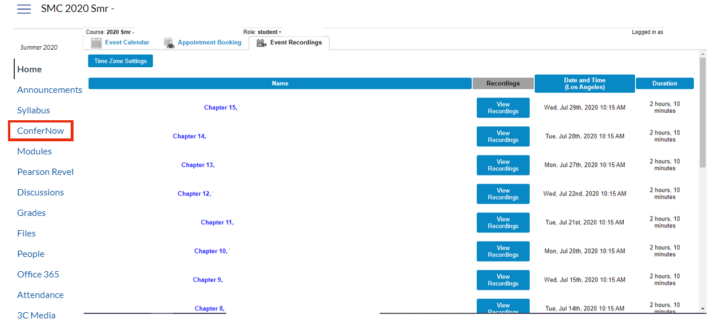
Zoom meetings can be scheduled two ways.
Within Canvas, it will be through ConferNow, located in the Course Navigation Menu. You can also view recordings of your Zoom meetings under the Recordings Tab.
21

Slide 22
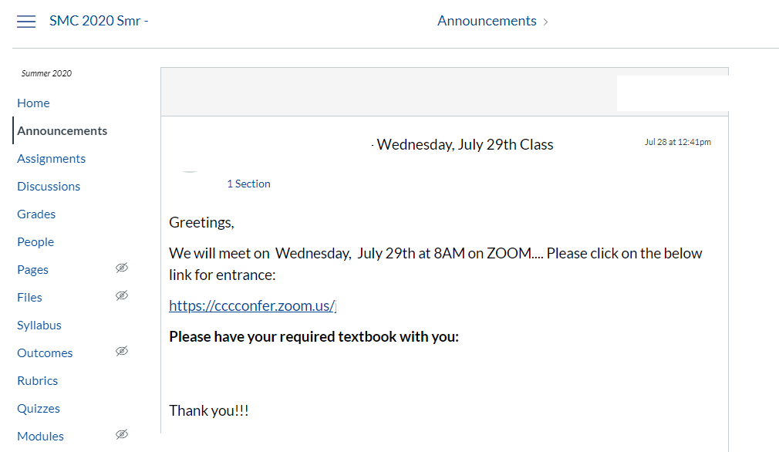
Zoom meetings can be scheduled two ways. The second way is through a Zoom link that your instructor may share with you through Canvas or email. This is a sample link posted in Canvas Announcements.

Slide 23
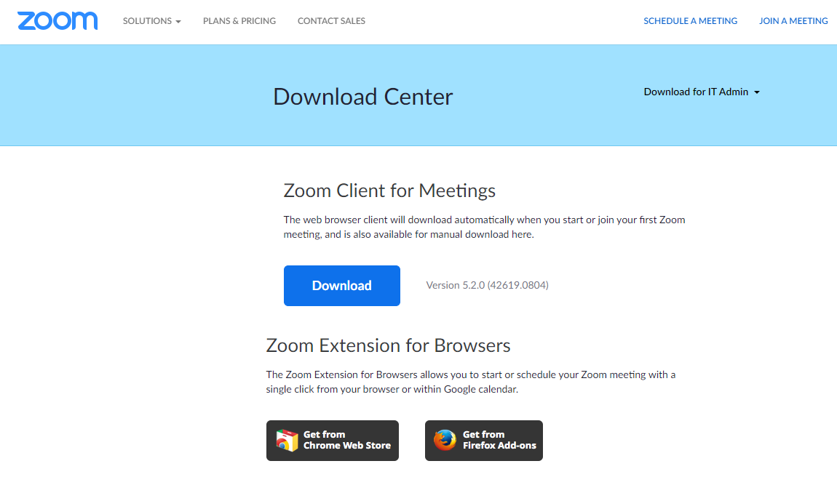
Zoom is an app that can be installed on your computer with a desktop app, a browser plug-in and you can also add the Zoom app on your mobile device (available in Google Play or App Store) Please refer to Zoom Help for additional information.
23

Slide 24




Types of Remote Instruction Delivery
Online - 3 Different Modalities UPDATE FOR NEXT YEAR
Scheduled
Fully online and will be taught through Canvas yet also require students to attend one or more Zoom meetings at the scheduled class time.
Flexible
Fully online and will be taught primarily through Canvas and other learning platforms that are flexible for the student’s schedule.
Flexible with Scheduled Exams
Taught primarily through Canvas and other learning platforms that are flexible for the student’s schedule, but with mandatory Zoom meetings for exams and quizzes.
24

Slide 25


Types of Remote Instruction Delivery
On Ground - 2 Different Modalities UPDATE FOR NEXT YEAR
On Ground
Fully on ground and will be taught in person at the time and location and listed in the schedule of classes.
Hybrid
Taught on campus and online.
25

Slide 26






THANK YOU
Distance Education Department
310-434-3760
SMCOnlineInquiry@smc.edu
www.smc.edu/OnlineEd
26

