Slide 1
NURSING STUDENTS spring 2020
student health services

Slide 2
Student Health services
The SMC Health Services Center is located adjacent to the welcome center and next to the cafeteria on the main campus.
Please check the SMC Student Health Center website for service hours for Winter & Spring 2020 semester.
Please call (310)434-4262 to verify hours of services and for questions.
www.smc.edu/healthcenter.
The SMC Health Services Center will render service to Nursing Students who are enrolled and have the current semester health fees paid.
Physical exams are not conducted at the health services. Students may utilize their own Health Care Provider or other resources.

Slide 3
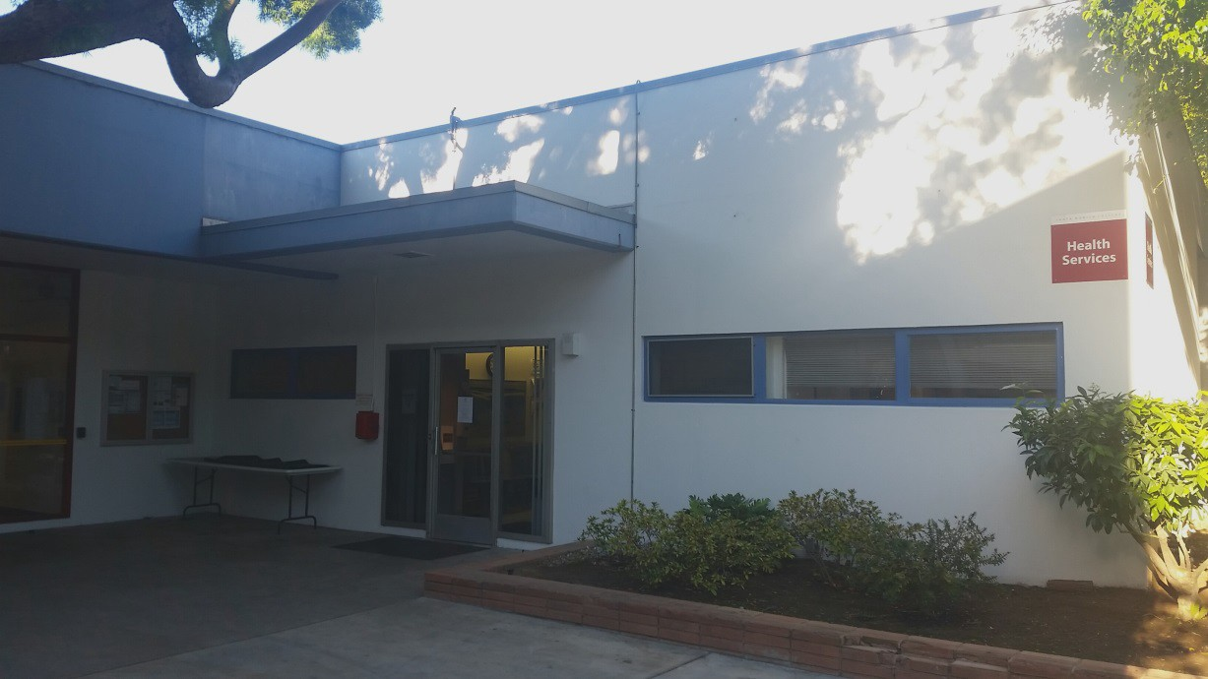
Student Health services
Please call for hours of operation and if you have any questions
310 434 4262

Slide 4
Services
Immunizations/vaccinations
Hepatitis B ($75 per shot) series of three injections required. 1st shot, 2nd shot a month after 1st, and 3rd shot 6 months after 1st. Series must be initiated prior to starting the program.
MMR (Measles, Mumps, Rubella) ($80 per shot): Administered as 2 shots, one month apart.
Tdap (Tetanus/Diphtheria/Pertussis) ($40): Proof of vaccination within the last 5 years required.
Varicella (chicken pox): $135
Polio Vaccination (NOT AVAILABLE AT SMC).
Flu Vaccination administered yearly prior to clinical rotations. Currently $14.

Slide 5
Services
Tuberculosis screening
TB Clearance for the Nursing Program is done by the 2 Step TB (Mantoux) test. 1st TB test cost is $18 & second TB test is $18.
The 2nd TB test is placed one week after the 1st is read. TB test must be read 48 to 72 hours after it is placed. Failure to return for reading requires a retesting fee of $25.
For a positive TB test or documented history of a positive TB test, a chest x- ray (CXR) must be done to document TB clearance.
CXR can be done for $30 with an SMC Health Services Center referral.
(Please note: TB Test must be read by a licensed Health Care Professional, i.e., MD, DO, PA, RNP, RN, LVN but not an MA, (Medical Assistant).

Slide 6
requirements
Completion of the blue confidential medical history form within 6 months of admission.
Numerical (IgG) titers: Green nursing student health requirement form.
UA with Micro
RPR copies of lab results required within the last 6 months of admission.
CBC
Immunizations i.e. Tdap, MMR, Varicella, Hep B, Influenza, Polio (records)
Proof of quantitative titers (numerical value) and not qualitative titers (non numerical) required.
TB screening (2 step)/CXR/TSPOT/Quantiferon Gold test.

Slide 7
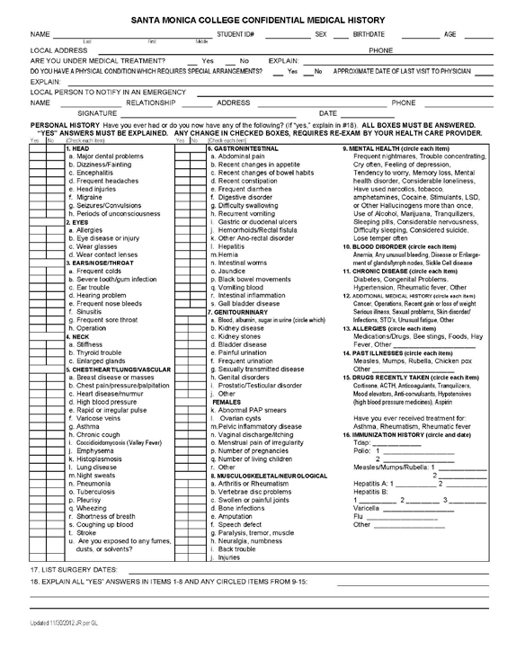
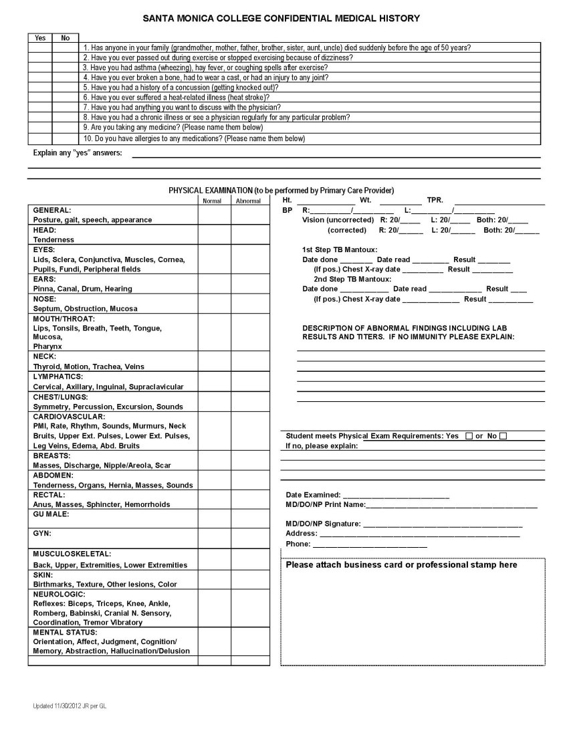
Confidential medical history form (blue form)

Slide 8
instructions
Student Health Services Center does not perform nursing physicals.
Nursing Physicals are to be completed by :
Medical doctor (MD)
Primary care physician (PCP)
Doctor of Osteopathy (DO)
Nurse Practitioner (FNP)
Physician Assistant (PA)
Quantitative titers indicate immunity level in numerical value and is required vs qualitative titers that state “immune” or “non immune” without any numerical value.
Copies of the titers should be turned in with all other lab work and immunization records.

Slide 9
instructions
If no records of prior vaccination get quantitative titers drawn.
If titers come back with low numerical value, get immunized or re-immunized.
Its imperative to make sure that your titers are quantitative IgG and not IgM.
Hepatitis B titers should be HbsAB IgG as in antibody titers and not HbsAG IgG as in antigen titers.
Post re-immunization, one should wait a minimum of 30 days for titers to be redrawn.
Retain all original forms except the physical (blue form) and the Lab (green form).
Turn in copies of all labs/immunization records with the original blue form and green form to the health science department.
Keep copies of everything.

Slide 10
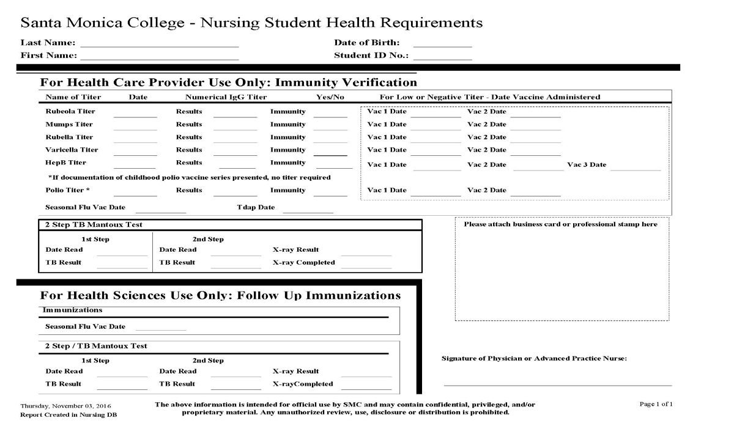
Immunization record (Green form)

Slide 11
Resources
CVS minute clinic: www.cvs.com
Reliant immediate care medical group: www.relianturgentcare.com
310 215 6020
Wellness mart md: www.wellnessmart.com
310 820 2150
Westside family health center: www.wfhcenter.org
310 450 2191

Slide 12
Questions?
Please contact the Health Sciences department with any further questions.
The student health services is here to assist you.
Please call the student health services for hours of operation 310 434 4262
Turn in all paperwork to the Health Sciences department.
Keep copies of everything.
Be responsible, be prepared and be proactive.

Slide 13
Thank you
TB clearance, lab work and titers
Physical Exam and completion/documentation on papers
Turn in paperwork and keep copies. Be cognizant of deadlines.

